Slide 1
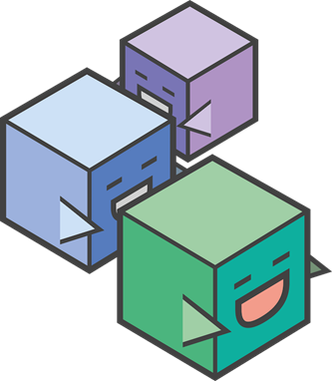
Blockchain
In a supply chain perishable network
John Ho & Kijana Effs
Notes:
Hello everyone! We are the intern duo exploring the use cases of Blockchain, the hot new tech buzzword, specifically in a supply chain network

Slide 2


The Innovation Interns
John Ho
From Duluth, GA
Rising 4th year at Georgia Tech
Computer Science major
People & Media thread concentrations
Interests: AR & VR, Innovative Tech, PC Building, Video Games, Ultimate Frisbee, Cooking
Kijana Effs
From Dallas, GA
Rising 5th year at Georgia Tech
Computer Science major
Info Networks & Devices thread concentrations
Interests: Engineering, Innovative Tech, Health & Wellness, Music, Service
Notes:
My name is John Ho and I’m a rising senior at GA Tech. I’m majoring in CS with people and media concentrations. These are some of my interests:
-Kijana introduces himself-

Slide 3
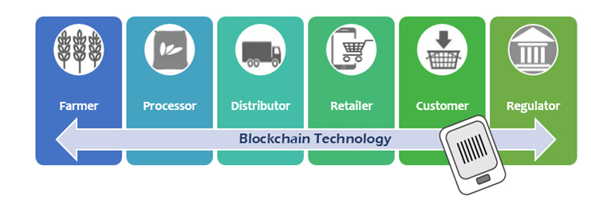
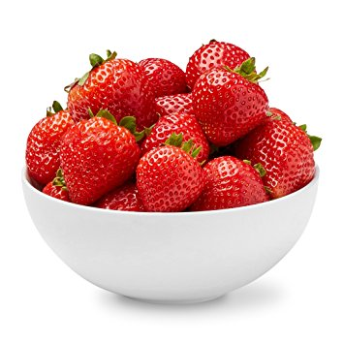
The Project Overview
Explore the use cases for a business blockchain network, not cryptocurrency!
Create a decentralized, distributed ledger that can track assets between participants in a supply chain network.
Potential benefits:
Automated smart contracts
Recall of a bad product
Consumer traceability
Notes:
-Kijana provides project overview-
So what are some high-level benefits of blockchain? Well with the help of the blockchain framework we’re developing on, we are able to define smart contracts. Smart contracts are essentially business rules coded into a blockchain network hence the name itself. It can be used for cases such as constant temperature monitoring or location tracking (with the help of IoT trackers that check if breaches ever occur and permanently log it on ledger), and automated payouts without the need of intermediates in between the process once it’s been delivered at the GPS location.
Blockchain is extremely helpful in the recall of a bad product. Say you have a bad romaine lettuce outbreak, and will need to recall it from your supply chain. Instead of throwing away all the romaine lettuce from every producer you’ve ordered from, you can query which products came from which producers that were affected from the blockchain. This way you can separate your good products from bad products.
Finally something cool on the customer side could be full traceability of the food you’ve ordered. With a blockchain-powered supply chain network setup, a customer could look up (on their phone for example) where this restaurant’s goods all came from, right down to the very farm that the strawberries were picked from. Everything is recorded into the ledger which is also immutable and tamper-proof from cryptography, so the customer can know with full confidence to trust that the food product was genuine.

Slide 4
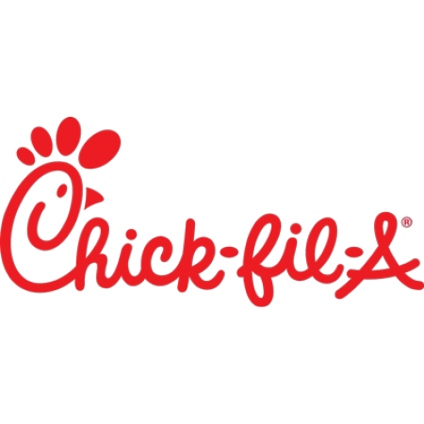

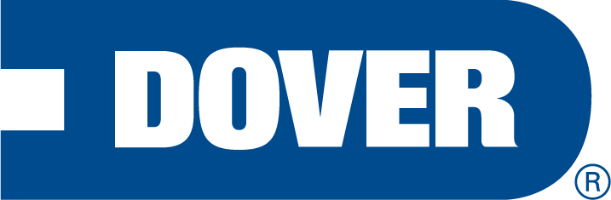
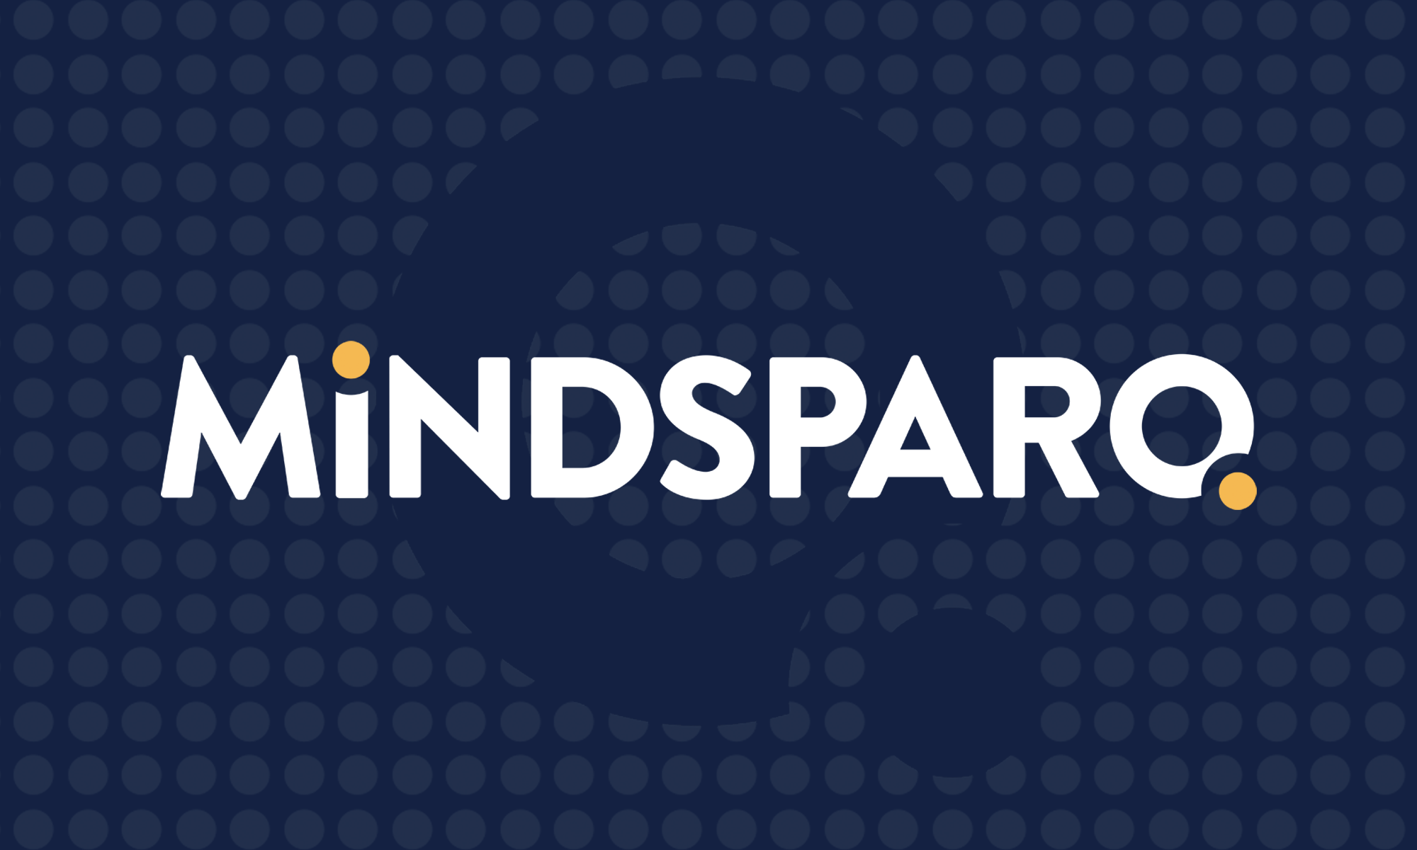
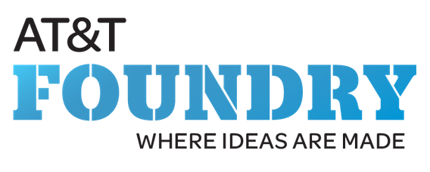

The Supply Chain Participants
(Producer)
(Warehouse)
(Retailer)
(Distributor)

Slide 5
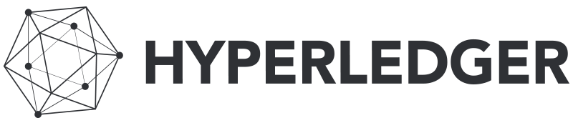
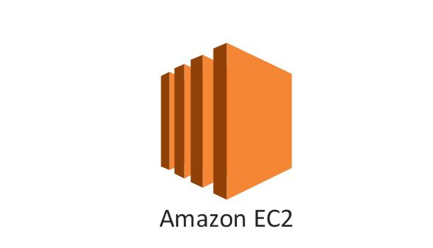
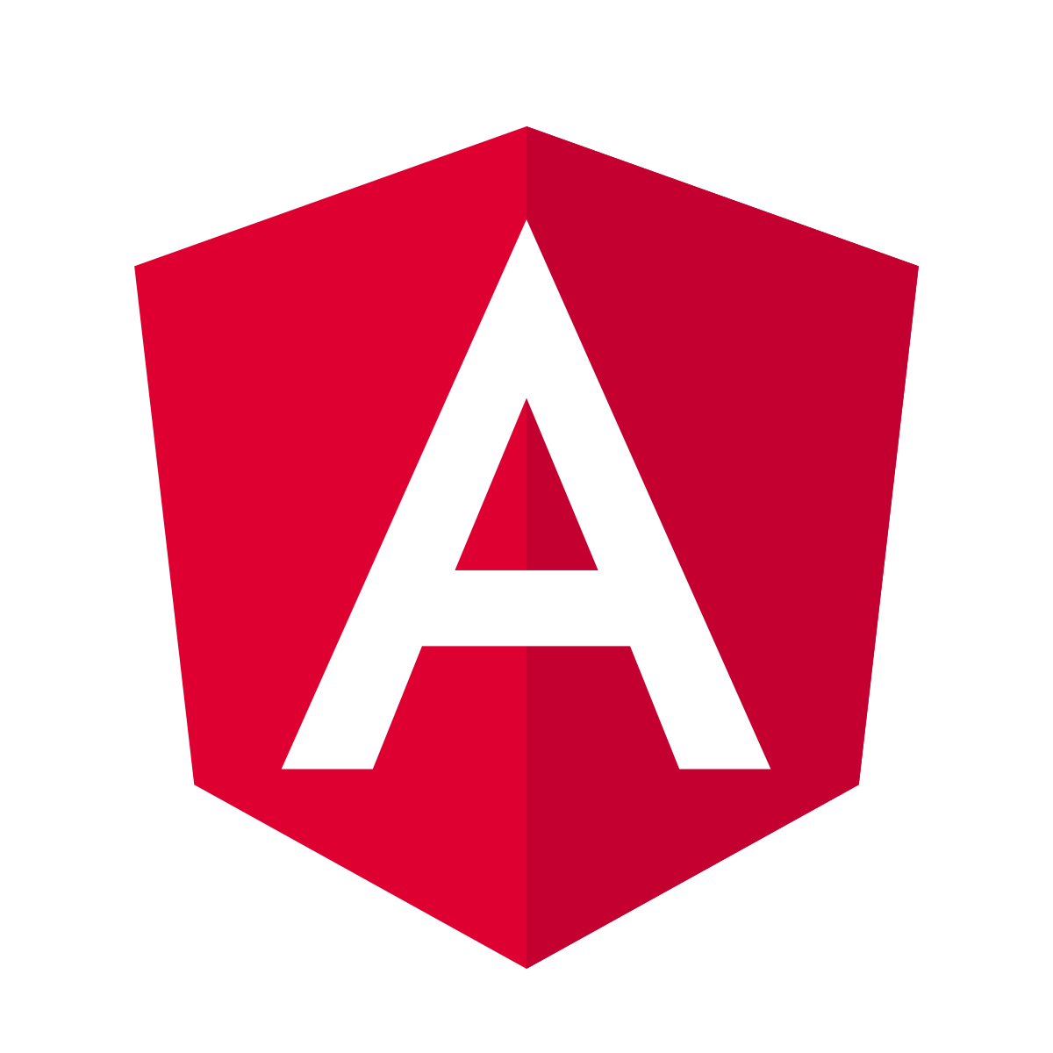
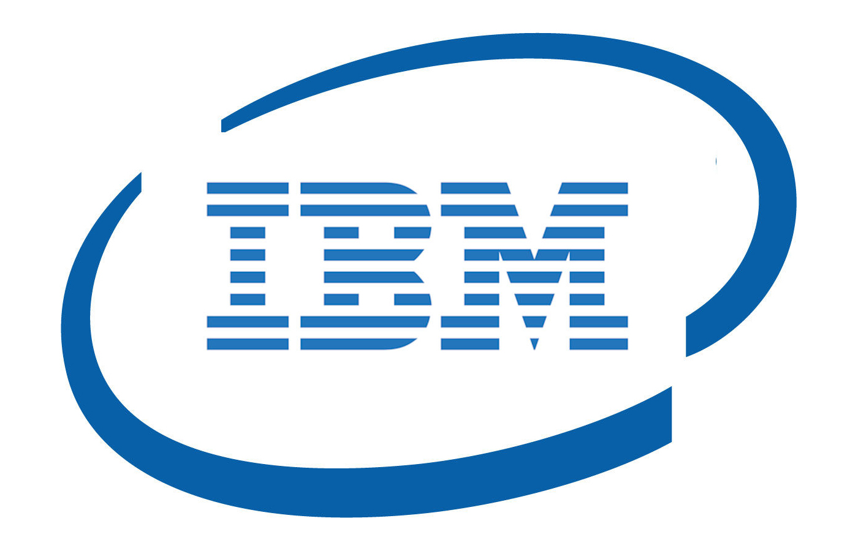
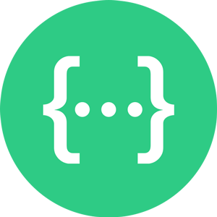
The Tools We Used
Hyperledger Fabric / Composer
IBM Blockchain Platform
AWS EC2 Instances
Angular (for web app)
Swagger API
Notes:
So these were the tools we used. After a few weeks of researching, we found that Hyperledger, a framework built by IBM was designed for implanting Business Blockchain solutions.

Slide 6
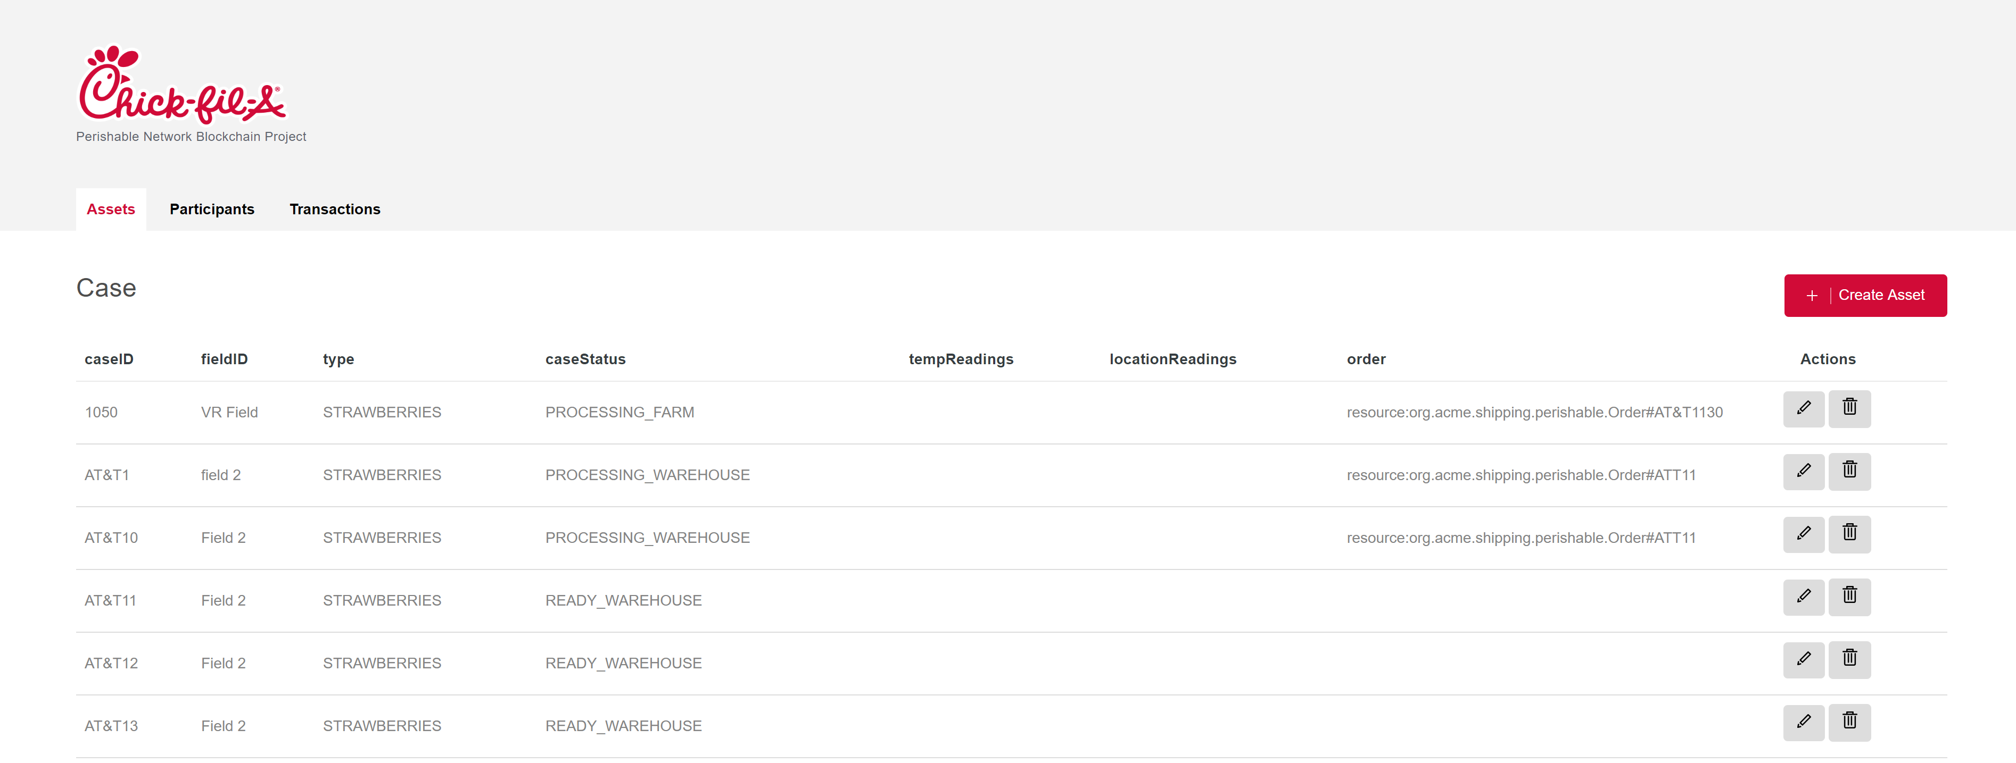
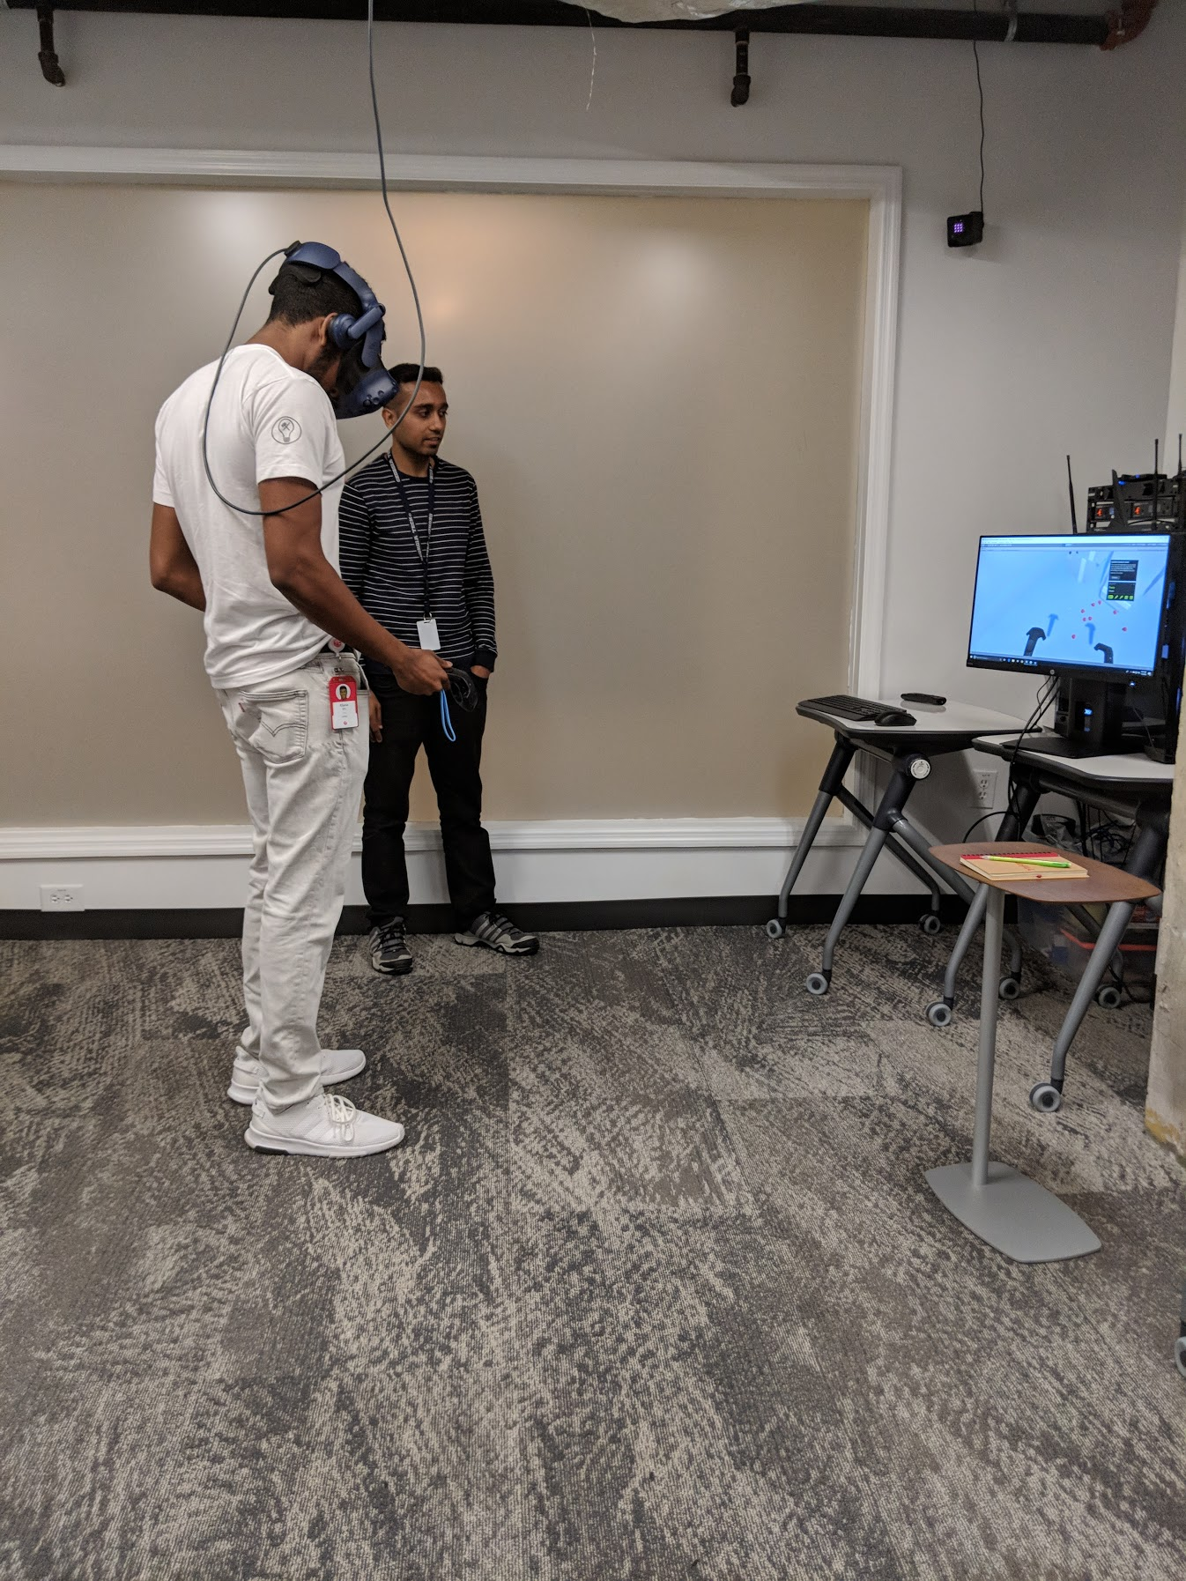
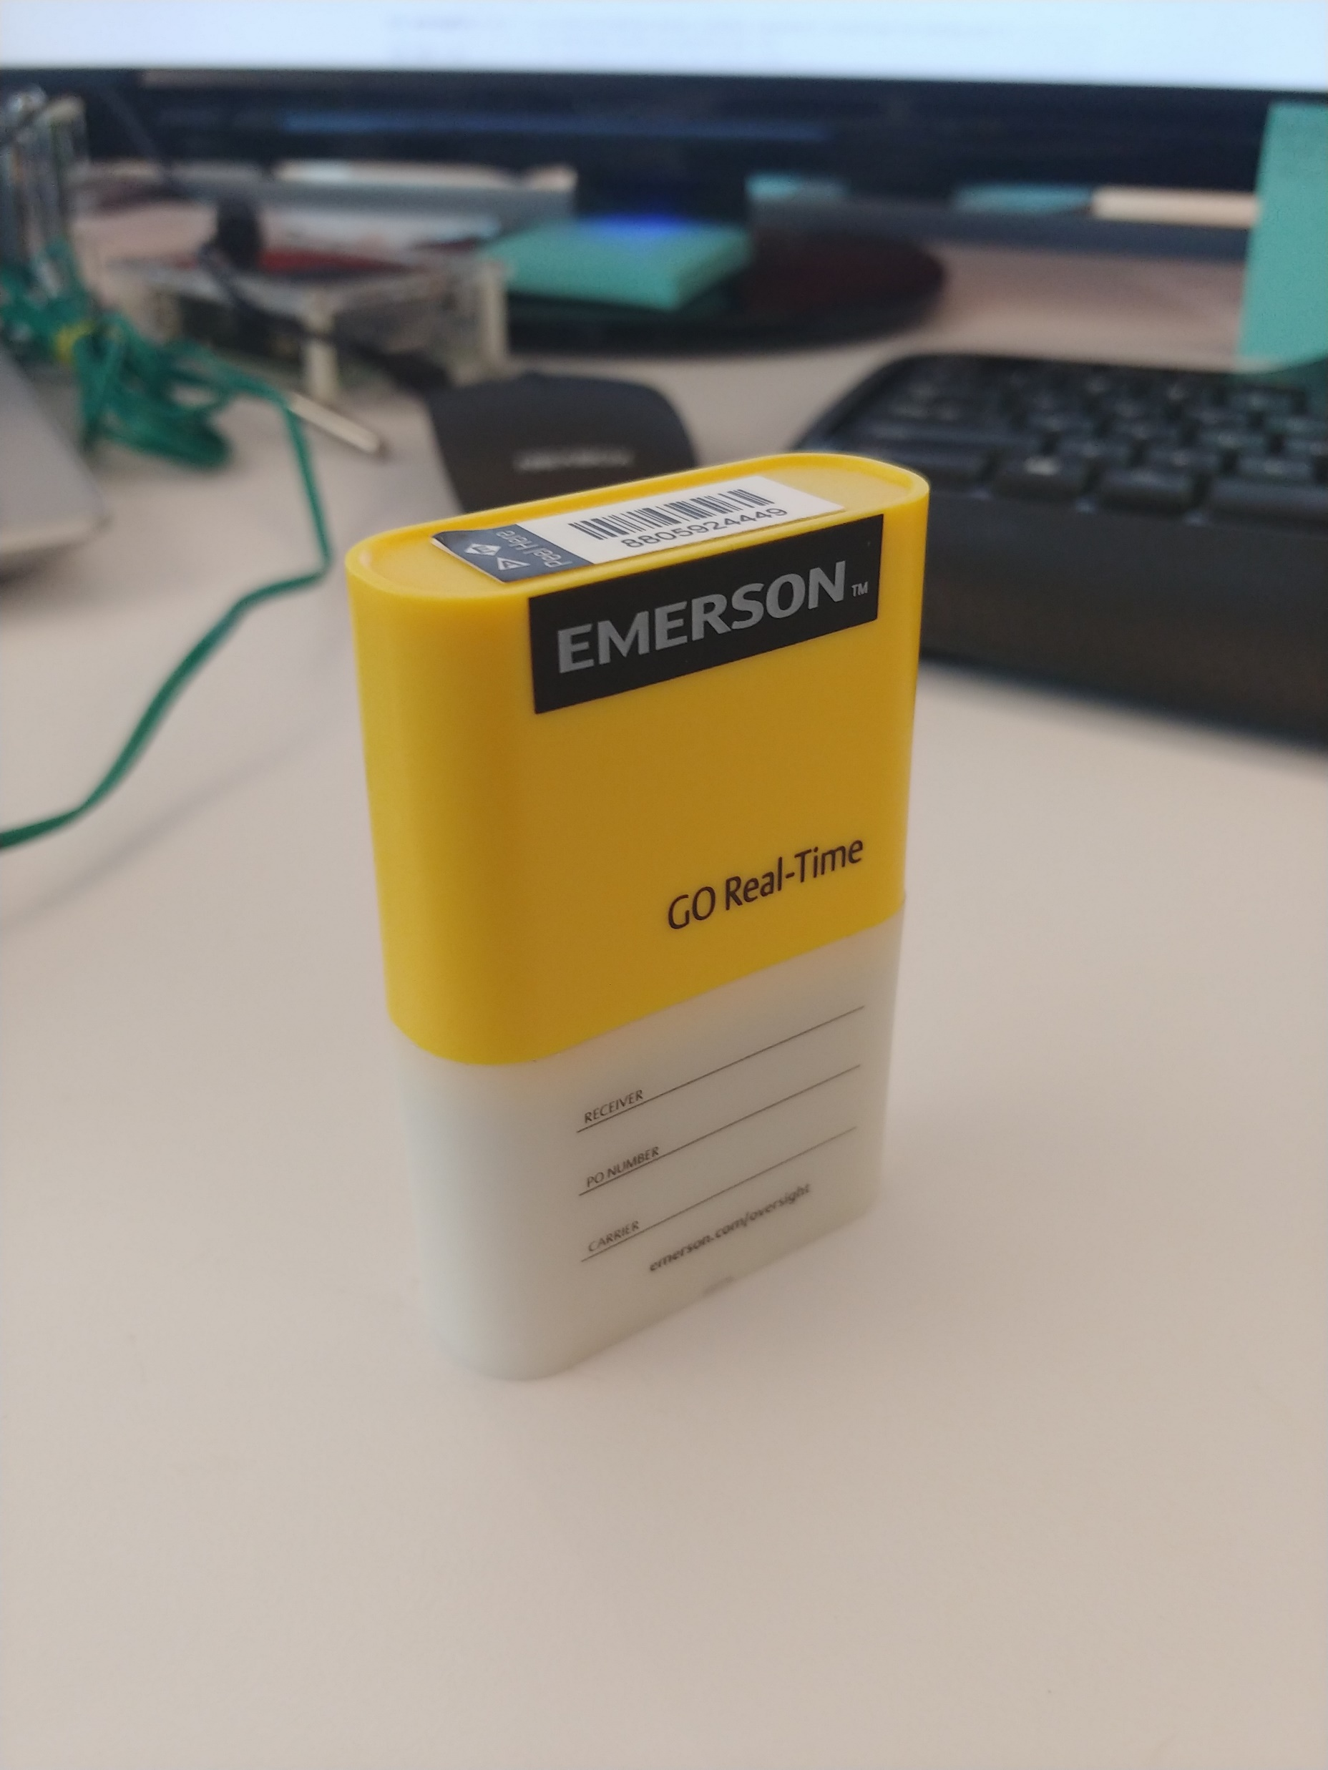
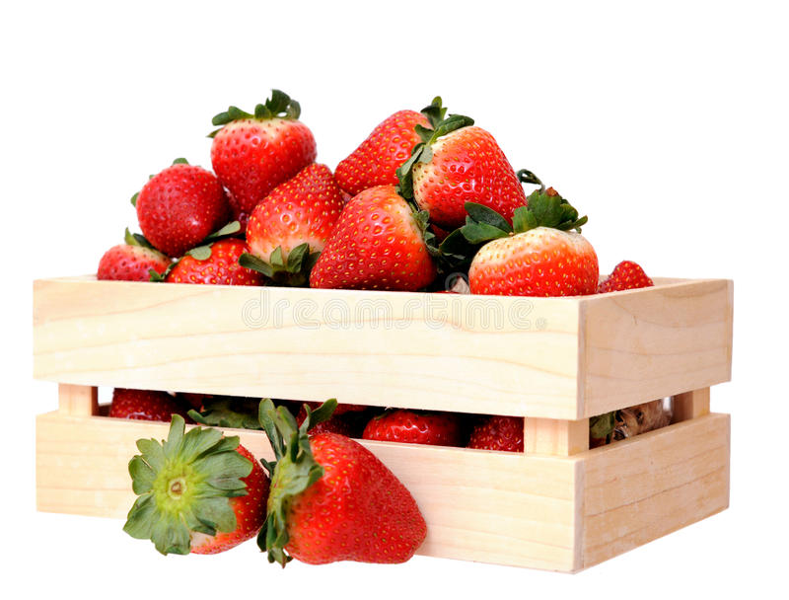
The Progress We’ve Made
Notes:
In around 6 weeks, we were able to fully design our Blockchain Architecture, define our APIs, and create a fully functioning Angular web app that can communicate with our blockchain network. We are able to query cases, check their statuses and temperature/locations, as well as do transactions through the web app itself.

Slide 7

QUESTIONS?

